Slide 1


Computer Fundamental Lab LAB # 05
Objective:
UML Designing | Prototype Designing | Database Designing
Prepared and Presented By: Engr. HAMZA

Slide 2

OUTCOMES OF UML Designing | Prototype Designing | Database Designing
Objectives/Outcomes
After this lab student will able to understand:
UML Fundamentals
Prototype Designing Concepts
Database Design Principles
Real-World Analogies
UML Diagram Types
Iterative Process of Prototyping
Entity-Relationship Diagrams (ERD) in Database Design
Integration of Design Components
Benefits and Best Practices

Slide 3

Introduction:
Title: Introduction to UML, Prototype, and Database Design
Content:
UML (Unified Modeling Language): Visual representation for designing software systems.
Database Designing: Structuring and organizing data for efficient storage and retrieval.
Prototype Designing: Creating a tangible model to visualize the user interface and interactions.

Slide 4
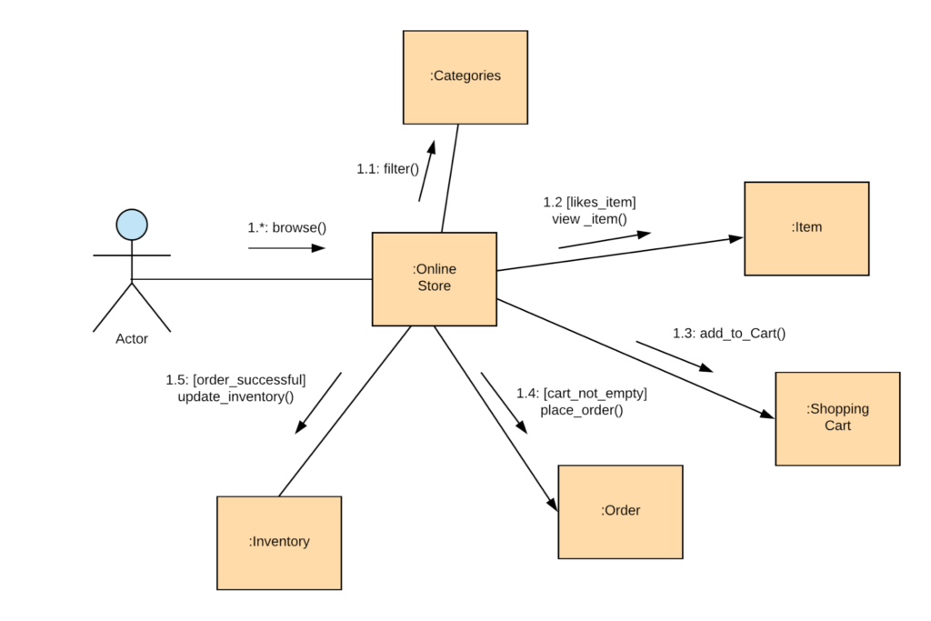
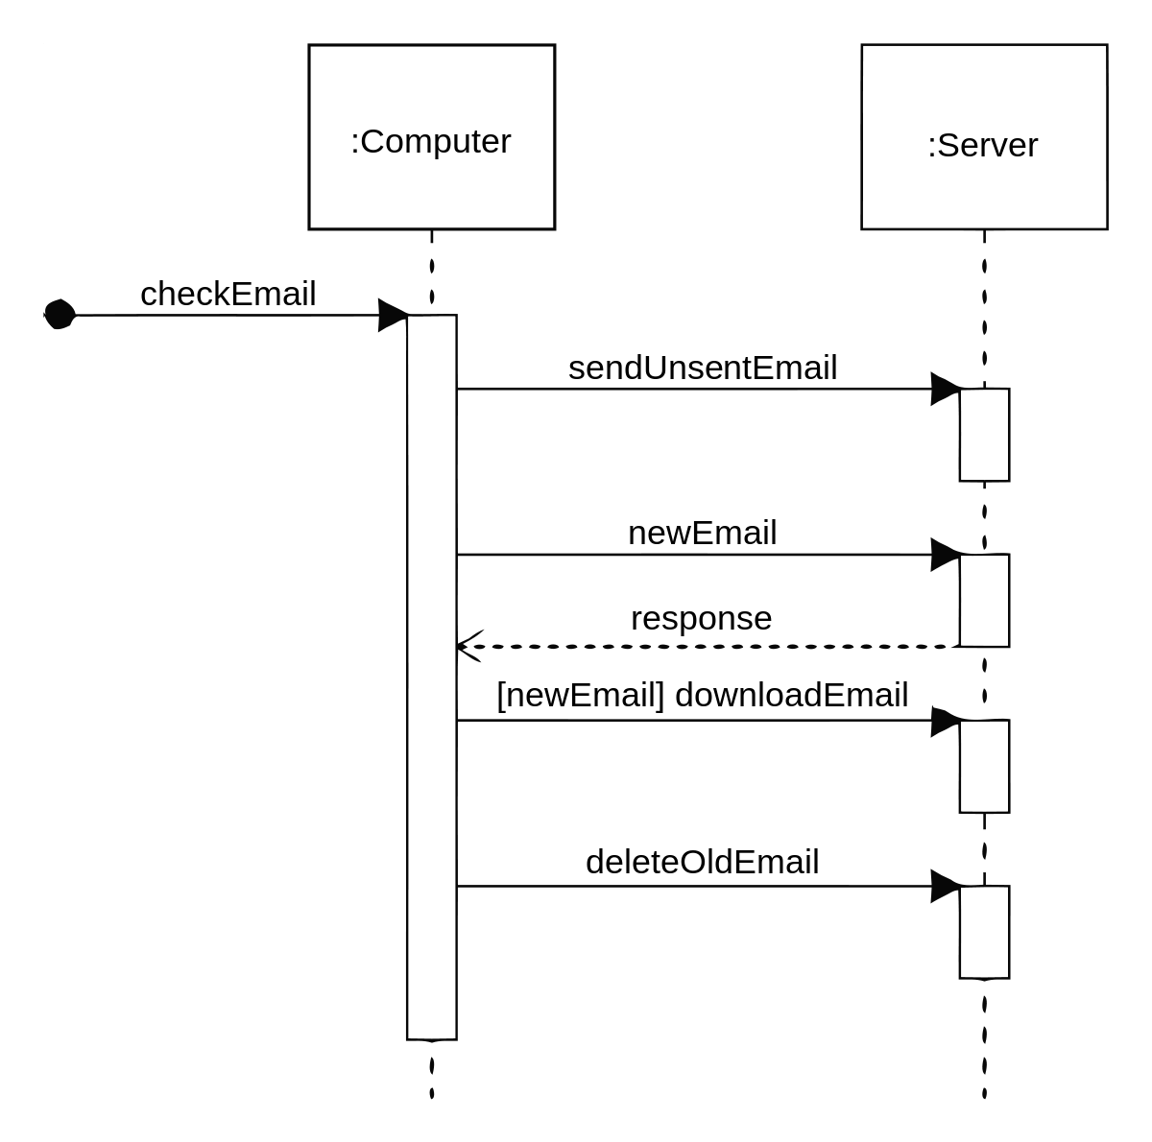
UML Designing
Title: UML Designing - Blueprint for Software
Content:
Visual Blueprint:
UML is like an architectural blueprint for software systems.
Diagram Types:
Use case, class, sequence diagrams, etc., to depict different aspects.
Real-World Analogy:
Just as architects use blueprints to plan buildings, UML helps plan software structures.

Slide 5
USECASE DIAGRAM TERMS
In a use case diagram, the following elements are typically included:
Actors: Actors represent the external entities (such as users, systems, or other entities) that interact with the system being modeled. Actors are depicted as stick figures or icons.
Use Cases: Use cases represent the specific functionalities or behaviors of the system. They describe the interactions between actors and the system to achieve a particular goal. Use cases are depicted as ovals.
Relationships: Relationships show the associations and dependencies between actors and use cases. The main relationship types are:
Association: Represents a communication link between an actor and a use case.
Generalization: Indicates that one use case is a specialized version of another use case.
Include: Denotes that one use case includes the functionality of another use case.
Extend: Represents an optional or alternative behavior that can be added to a base use case.
System Boundary: The system boundary defines the scope of the system being modeled and distinguishes it from the external entities.
Stereotypes: Stereotypes provide additional information about use cases, actors, or relationships. They are displayed as text in guillemets (<< >>) and can represent different categories or types of elements.

Slide 6
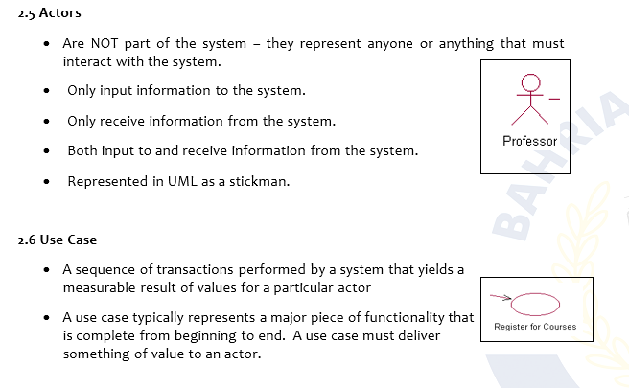
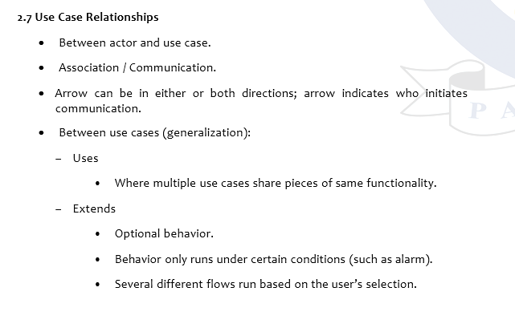
UML TERMS:

Slide 7
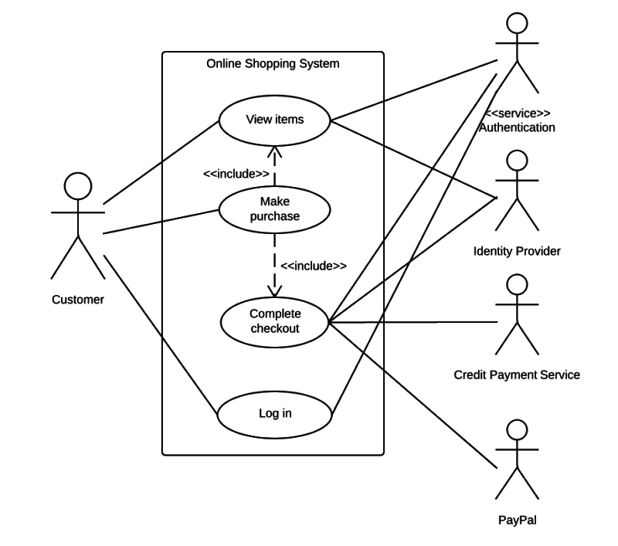
USECASE DIAGRAM:

Slide 8
COMPONENTS OF SEQUENCE DIAGRAM:
In a sequence diagram, the following components are typically included:
Lifelines: Lifelines represent the participants or actors involved in the interaction. They can be objects, entities, or components. Lifelines are depicted as vertical lines.
Messages: Messages represent the communication or interaction between lifelines. They depict the flow of information or actions between lifelines. Messages can be synchronous (indicated by a solid arrow), asynchronous (indicated by a dashed arrow), or self-referential (loopback arrow).
Activation Boxes: Activation boxes represent the period of time during which a lifeline is actively involved in processing a message. They show when a lifeline is executing a particular action or method.
Return Messages: Return messages depict the response or return values sent back from the receiver to the sender after the completion of a method or action.
Combined Fragments: Combined fragments are used to represent conditions or alternative paths in the sequence diagram. They include options, loops, and alternatives, which allow for more complex interactions.

Slide 9
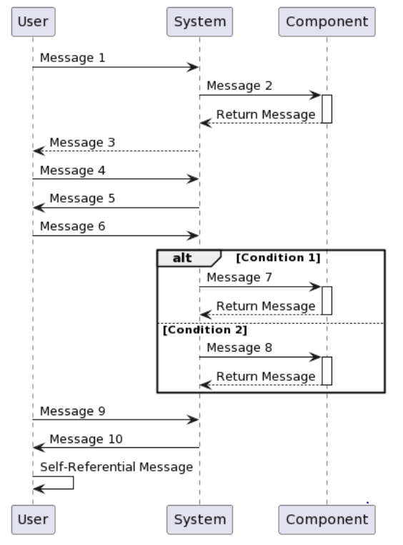

Slide 10
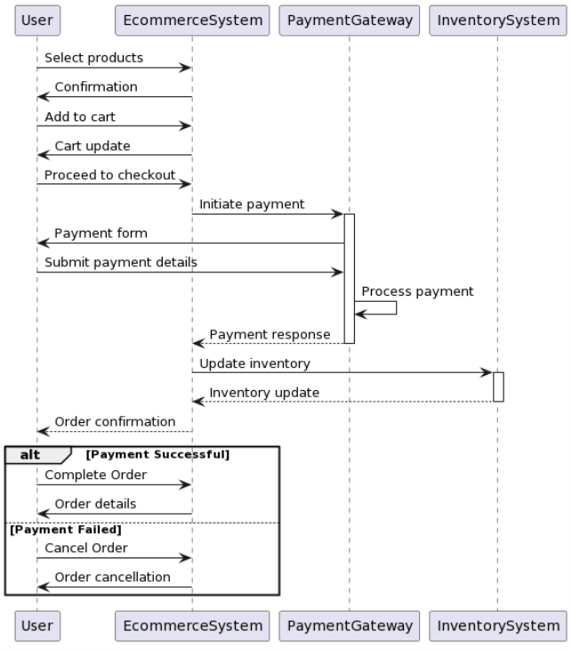
EXPLAINATION WITH SCENERIO

Slide 11
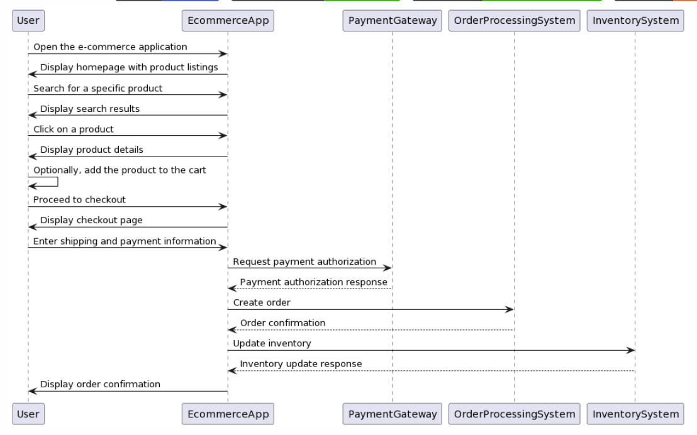
SEQUENCE DIAGRAM

Slide 12
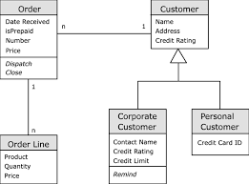
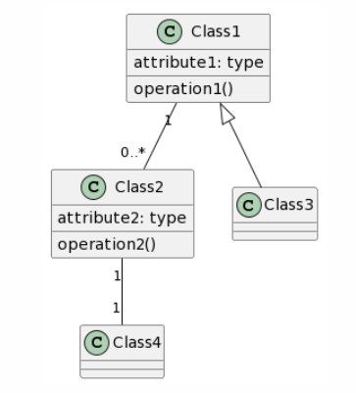
UML Example - Class Diagram
Title: UML Class Diagram
Content:
Purpose:
Represents classes, their attributes, and relationships.
Real-World Analogy:
Like a family tree, showing relationships between different entities.

Slide 13
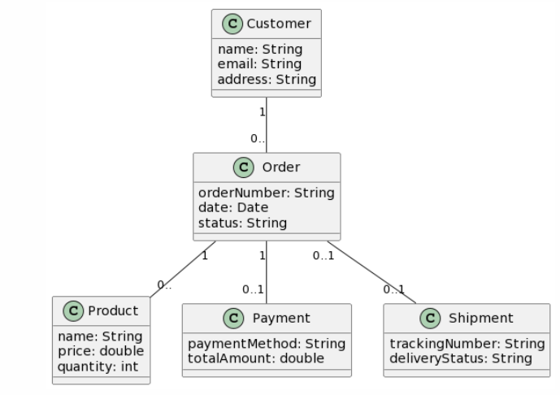
Class diagram of ecommerce scenario

Slide 14
Components of data flow diagram:
Processes: Processes represent the activities or transformations that occur within the system. They can be manual or automated actions that manipulate the data. Each process has inputs, outputs, and data stores associated with it.
Data Flows: Data flows represent the movement of data between processes, entities, and data stores. They show how information is transferred from one component to another within the system.
External Entities: External entities are external systems, organizations, or individuals that interact with the system. They are represented as rectangles in the DFD and demonstrate the sources or destinations of data.
Data Stores: Data stores are repositories where data is stored. They can be databases, files, or any other form of storage. Data stores are represented as rectangles with two parallel lines on each side in the DFD.
Data Flow Diagram Symbols: DFDs use symbols to represent different components. For example, an arrow represents a data flow, a circle represents a process, a rectangle represents an external entity, and parallel lines represent a data store.
Control flow is represented by arrows in a DFD, just like data flows. However, control flows are labeled with control information, such as "if-then-else" conditions or loop statements. They indicate the flow of control from one process to another, showing the order in which processes are executed.

Slide 15
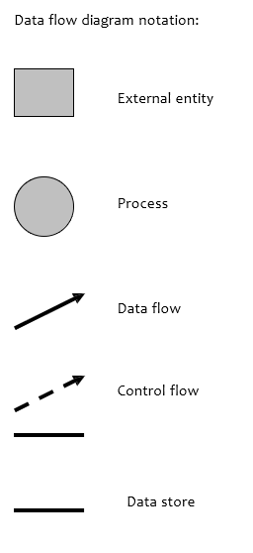
Data flow diagram:
A data flow data diagram is one means of representing the functional model of a
software product. DFDs do not represent program logic like flowcharts do.

Slide 16
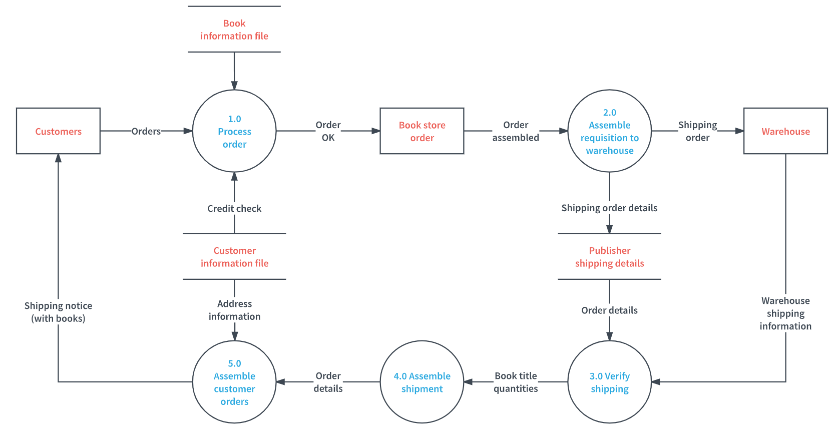
Example:

Slide 17
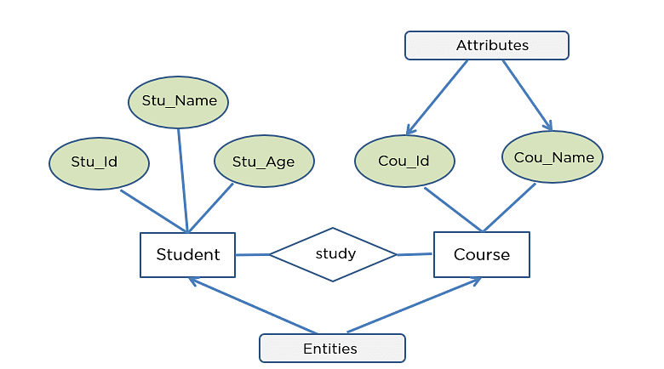
Database Designing
Title: Database Designing - Structuring Information
Content:
Organized Storage:
Designing how data will be stored, organized, and accessed.
Efficient Retrieval:
Ensures efficient retrieval of information when needed.
Real-World Analogy:
Like organizing a library where books are categorized for easy retrieval.

Slide 18
Components of erd diagram:
Entities: Entities represent the objects or concepts in the database system. They can be tangible things like a customer, product, or employee, or intangible concepts like an order, transaction, or reservation. Entities are represented as rectangles in an ERD.
Relationships: Relationships define the associations between entities. They represent how entities are connected or related to each other. Relationships can be one-to-one, one-to-many, or many-to-many. They are represented as diamonds in an ERD, and lines connect the related entities.
Attributes: Attributes describe the properties or characteristics of an entity. They provide more detailed information about the entities and relationships. Attributes can be simple (e.g., name, age) or composite (e.g., address with multiple sub-attributes). They are represented as ovals connected to the respective entity.
Cardinality Constraints: Cardinality constraints define the number of instances of one entity that can be associated with another entity. For example, a customer can place multiple orders, but an order can be placed by only one customer. Cardinality constraints are represented using numbers or symbols near the relationship lines.
Primary Keys: Primary keys are unique identifiers for each entity instance. They uniquely identify each record in a database table and are used to establish relationships between entities. Primary keys are denoted in an ERD with an underline.

Slide 19
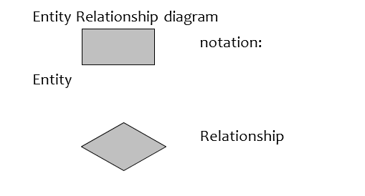
Database Example - Entity-Relationship Diagram
Title: Entity-Relationship Diagram (ERD)
Content:
Purpose:
Represents entities, relationships, and attributes.
Real-World Analogy:
Similar to a family tree, showing relationships between different entities like people and their roles.

Slide 20
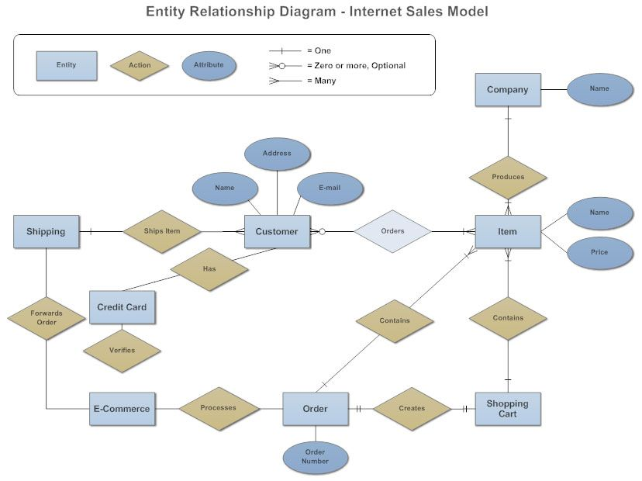
EXAMPLE :

Slide 21
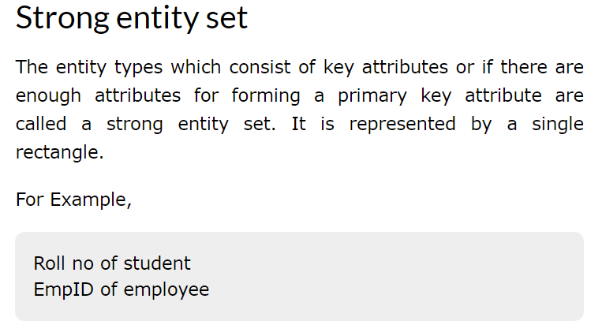
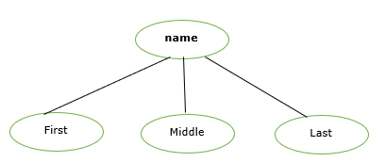
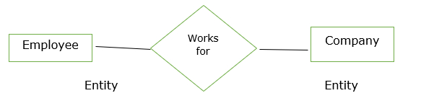
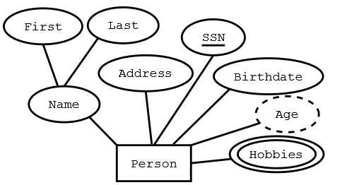
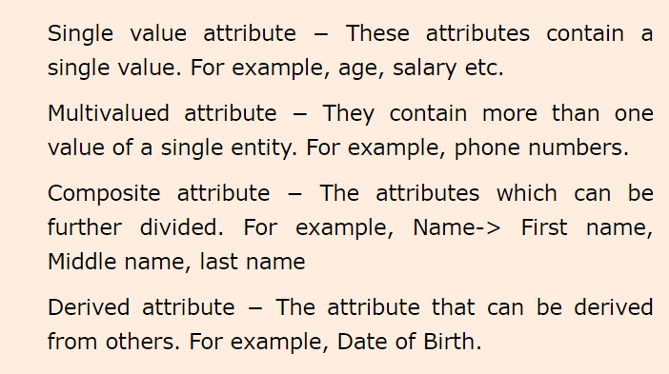
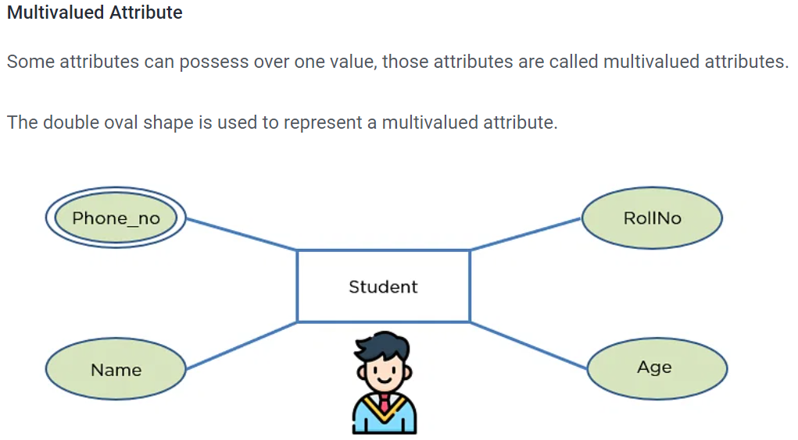
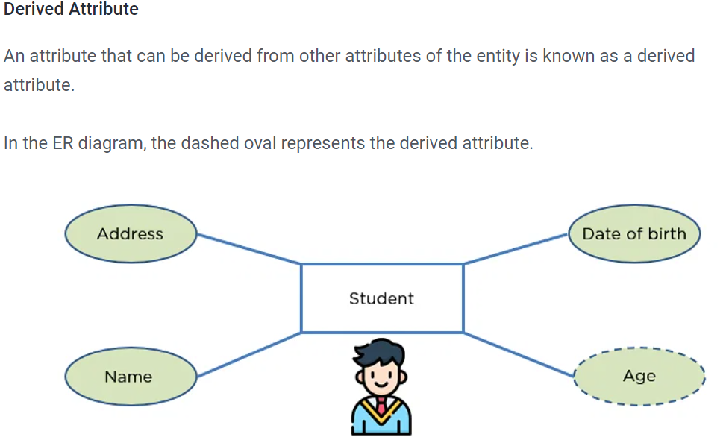
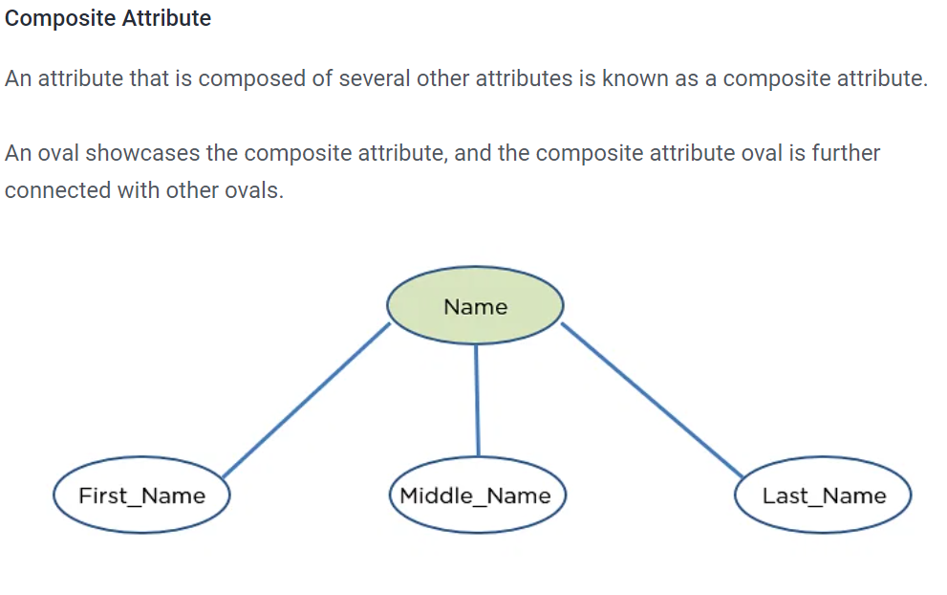
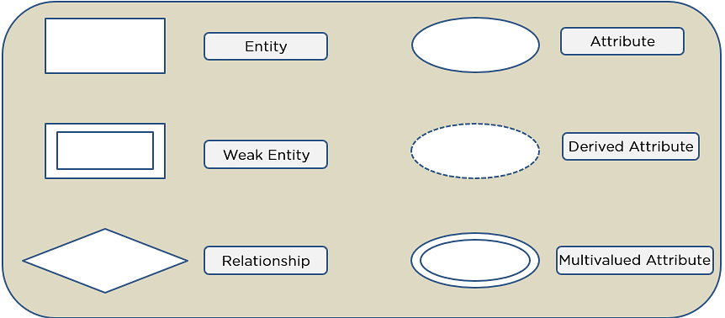
Example:

Slide 22
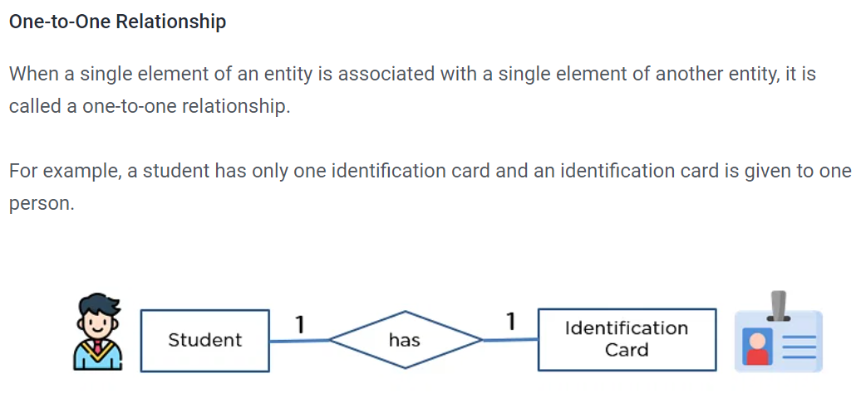
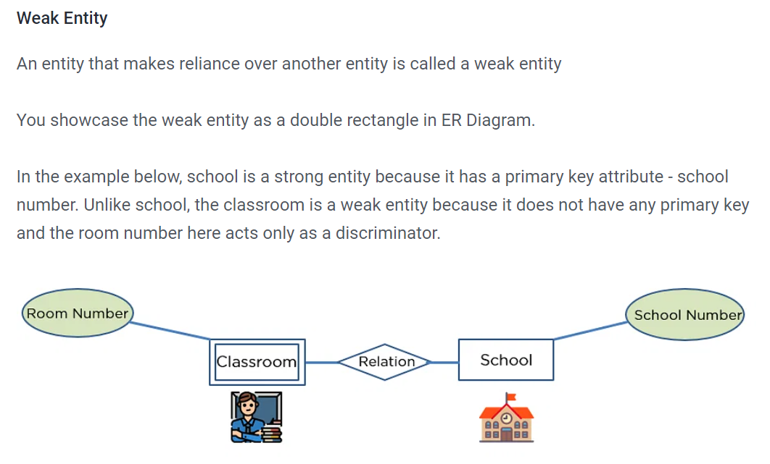
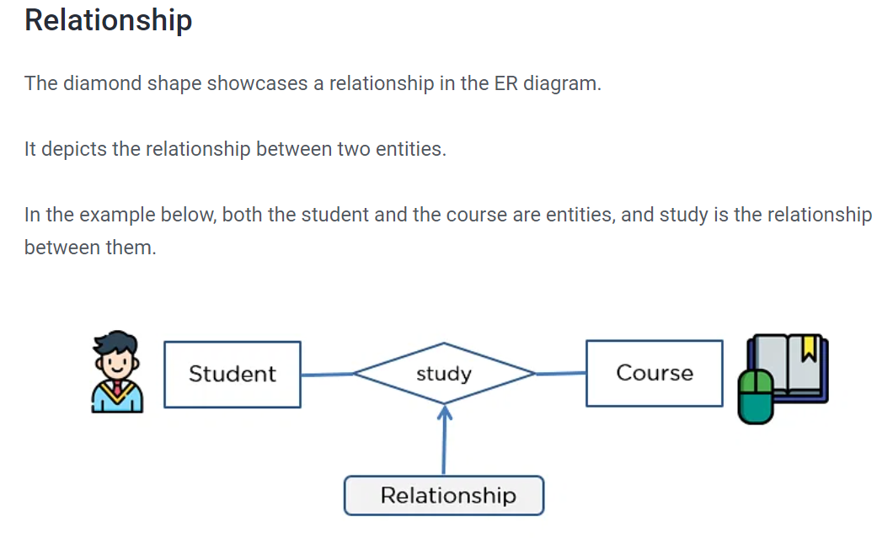
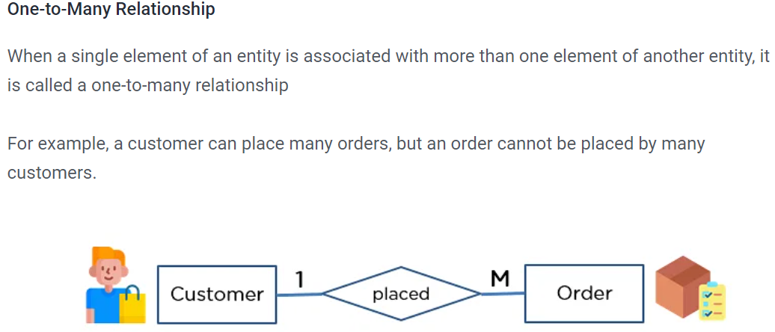
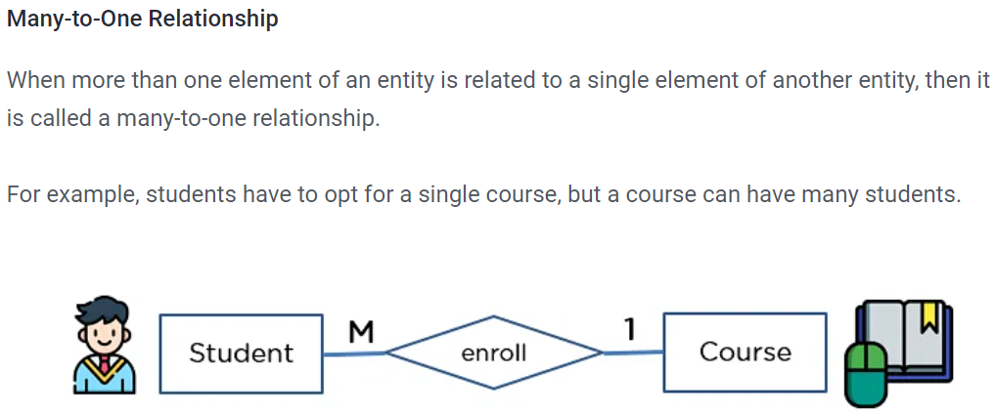
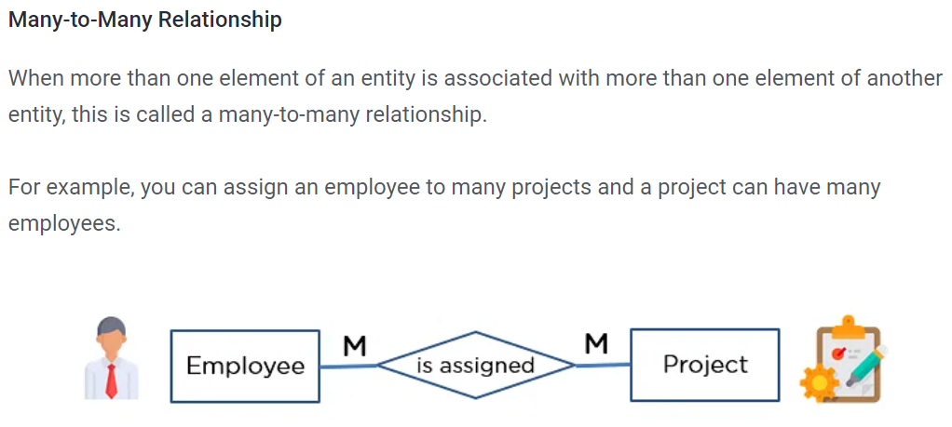
Components of er diagram:

Slide 23
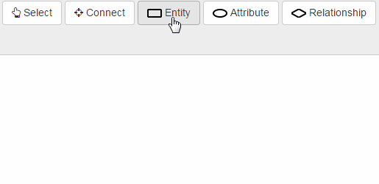
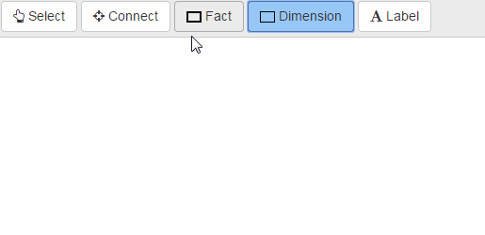

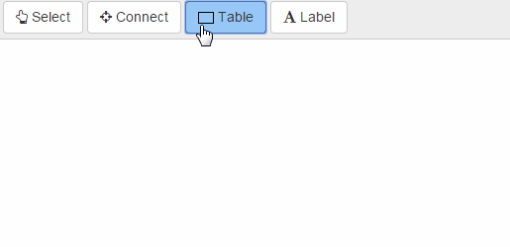
ERDPLUS TOOL

Slide 24
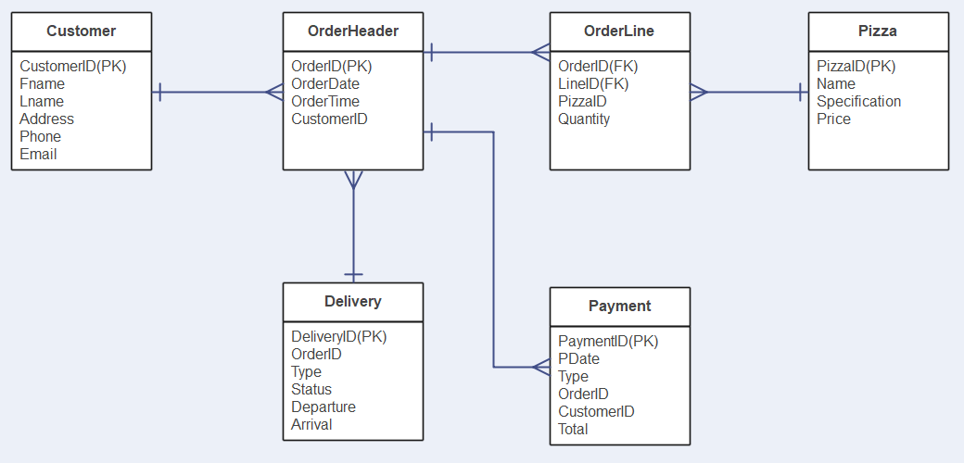
Example of erd:

Slide 25

Prototype Designing
Title: Prototype Designing - Bringing Ideas to Life
Content:
Interactive Model:
Prototypes are interactive models showcasing the user interface and functionality.
Iterative Process:
Facilitates feedback and refinement before full development.
Real-World Analogy:
Prototypes are like sketches for a product before the final design.

Slide 26
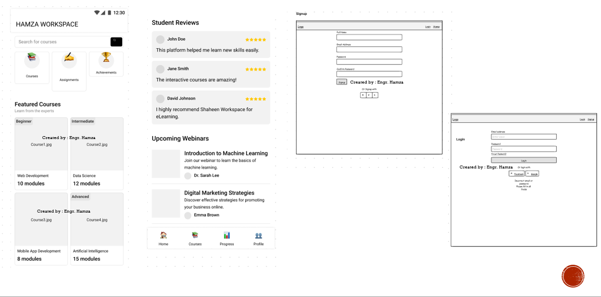
Example of e-learning prototype

Slide 27
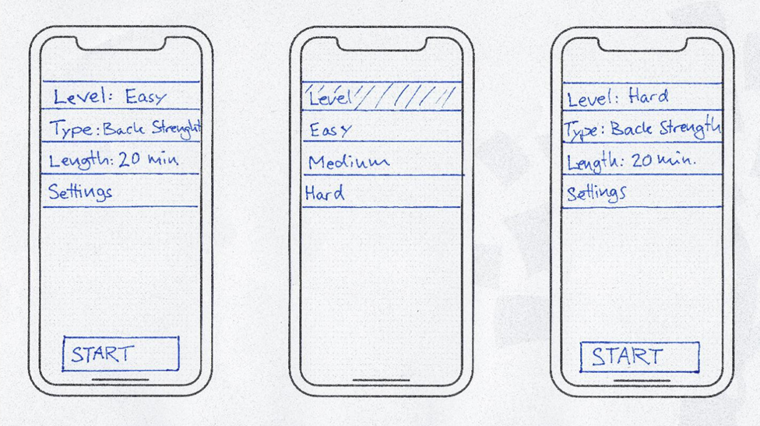
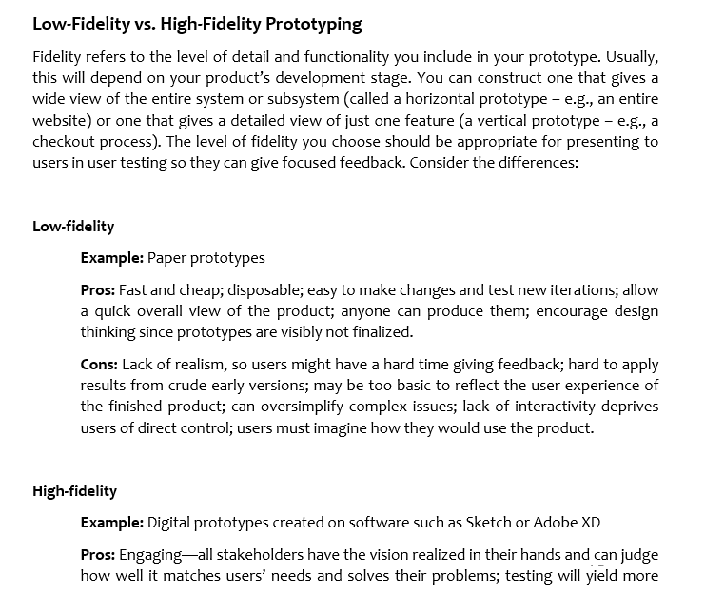
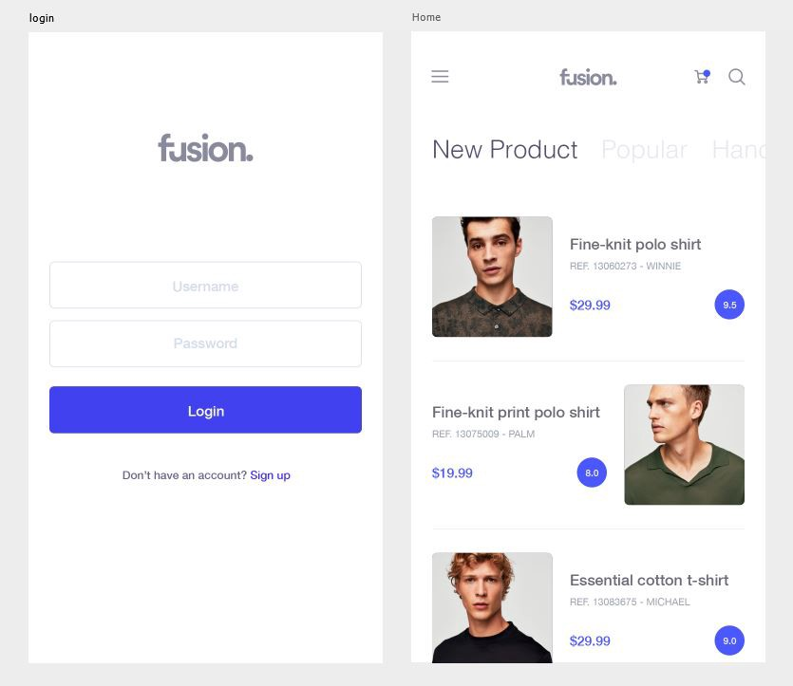
PROTOTYPING TYPES:

Slide 28
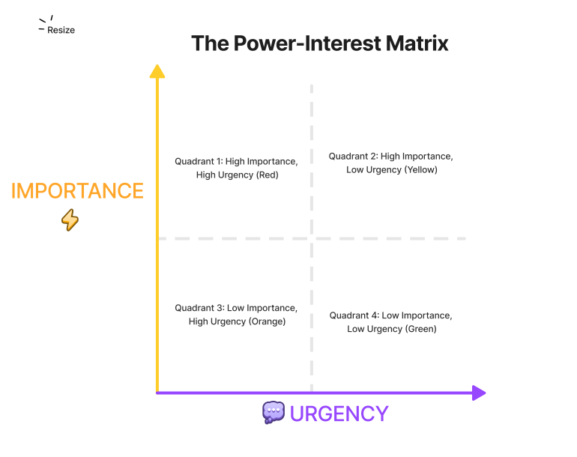
Importance urgency matrix

Slide 29
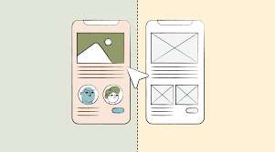
Prototype Example - Wireframe
Title: Prototype Wireframe
Content:
Purpose:
Wireframes represent the skeletal structure of a user interface.
Real-World Analogy:
Similar to a skeleton model used in fashion design to showcase the garment structure.

Slide 30
Benefits and Best Practices
Title: Ensuring Success in Designing
Content:
Benefits:
Improved communication, early issue identification, streamlined development.
Best Practices:
Regular updates, collaborative feedback, and adapting to changing requirements.
Real-World Analogy:
Similar to a well-coordinated team in any project, where communication and adaptability are key.

Slide 31

TOOLS USED:
DRAW.IO
FIGMA
ERD PLUS

Slide 32

TASKS:
Create and Design of your Semester project :
Use case Diagram
Sequence Diagram
ERD Diagram
DFD Diagram
prototype designing

Slide 33

THANK YOU

